Slide 1


Slide 2
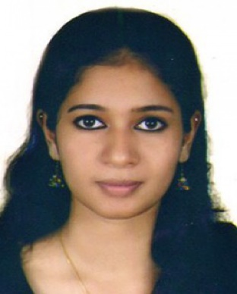
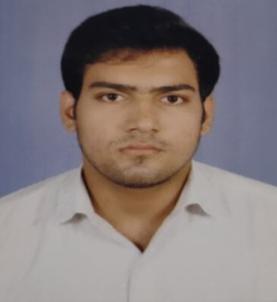
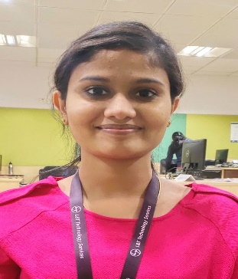
Project Highlights
Project Name : A patient record monitoring using python
Team Size : 3
BU Mentor Name : Mentor PS#
Team Members Details
Shahna S S
PS No:99002550
2009MYSEB03
M.tech: AEI
Raj Shekhar Mishra
PS No:99002616
2009MYSEB03
B.tech: ECE
Neema Zacharias
PS No:99002557
2009MYSEB03
M.tech: MNE

Slide 3
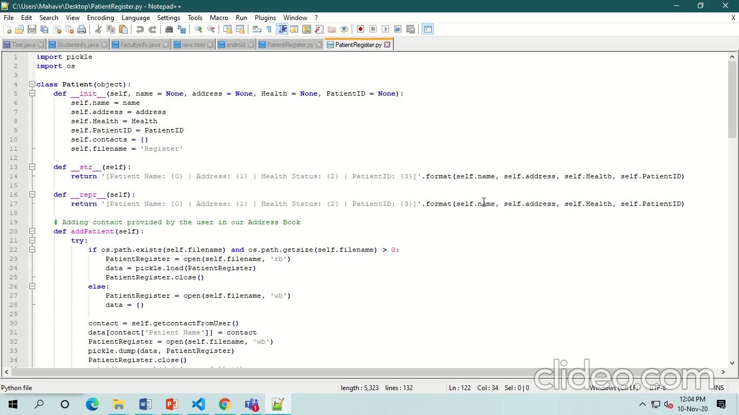
Project Video Snippet

Slide 4
Future development that can be implemented further
Hospital management system with database.
An application with more functionalities.

Slide 5


Thank You !

